Slide 1

SGO Area: Digital Commercial– Field Force Engagement Problem Statement:
With advent of digital touch points, how can we devise an user friendly Artificial Intelligence (AI)/Machine Learning (ML) solution to support Sales Representative Targeting strategies, Marketing Call plans and Next Best Action (NBA) to maximize Return of Investment (ROI) of each marketing call Team Captain ID: 434896 - Raju Chowdhury Team Member ids: 174230; 439274; 555224; 713538; 373727; 380324; Account name: AbbVie Inc. Date: 30th Jun 2019

Slide 2

Table of Contents
Executive Summary
Business Need
Capability and Functionality Overview
High Level Process View
Pre-Post Assessment
Innovation / Business Impact
Use Case 1
Use Case 2
Use Case 3
Use Case 4
Prototype Readiness
Recommended Implementation Schedule
Risks
Financials—Costs
Financials—ROI

Slide 3
Executive Summary
Problem /Mission Statement: With advent of digital touch points, how can we devise an user friendly Artificial Intelligence (AI)/Machine Learning (ML) solution to support Sales Representative Targeting strategies, Marketing Call plans and Next Best Action (NBA) to maximize Return of Investment (ROI) of each marketing call.
Solution: The solution is primarily targeted to support Sales Rep and Regional/Area Sales Managers (ASM). The sales rep would be able to deliver right strategies to right Health Care Professionals (HCP)/Accounts which will expand the product reach. The ASM can have better control over their territory. Further, the data and analysis planned should support Brand/ Marketing managers plan their investments better.
Benefits to Client
Easy deployment/customization across any market
Standardized approach for better comparison and best practice sharing
User friendly solution for wider acceptance
Helps in designing the right ‘Go to Market Strategy’
Understand the driving factors for across customer segments
Helps to understand the writing pattern of HCPs
Assistance to Reps in strategizing their next call through NBA
HCP 360 view: Empower Reps to ‘KNOW THE CUSTOMER’ and focus on their sentiments for better impact

Slide 4
Executive Summary (Cont.…)
Critical Features :
Segmenting HCP according to their drug prescribing pattern and other key attributes using ML Clustering Algorithm for better targeting strategy
Generating composite score through for each HCP’s/Accounts to optimize the ROI
Analyzing the Physicians sentiments on market, product and offering using Deep Learning
Building a 360 view of consumer becomes imperative for the customer-centric marketing paradigm and delivering customizing messages for better penetration
Technology Stack : PYTHON, HTML, DB to be aligned as per Client infrastructure
Scalability / Reusability /Sustainability
Light solution which can be easily deployed across markets/geographies/countries
At present, most of the global organization have localized approach where the SFE activities are carried on silos. This solution is intended to bring centralized process with flexibility for customization to get best of both approaches
Companies are turning to sales force effectiveness tools in order to better equip their stakeholders (HCPs, Reps, etc..) with digital edge and help survive the competition in the market
Why should your client invest in this solution?
SFE activities (Alignment, Segmentation, Call Planning) are done at least once a year and some phase are executed more than once. This solution should provide perfect platform for Client to understand each salesforce team and brand performance in a more holistic manner and our AI/ML approach will learn from each iteration and provide next based actions to enhance ROI

Slide 5
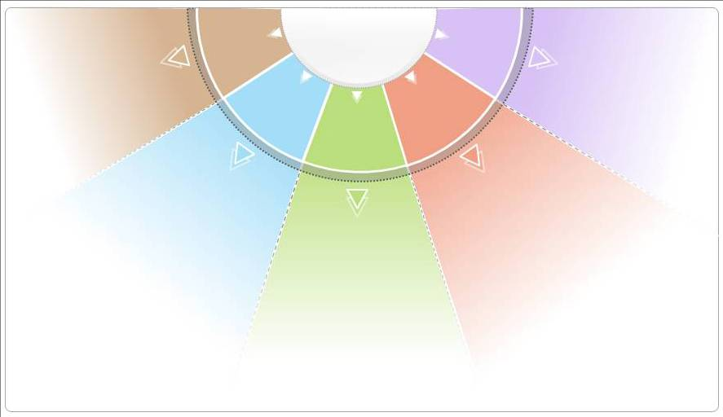

Business Need
Purpose:
With a retrospective view towards the ever changing marketing landscape of pharma Sale force and market access, sales reps are having fewer interactions with physician, that eventually hampers the Sales Force Effectiveness (SFE) and it is essential to equip the reps with the right information, at the right time about an HCP
In order to devise a successful go-to-market strategy, sales representatives must be aware of the factors that drive sales which includes knowing the preferences of their customers
Define objectives that promote growth on selling drug revenue through SFE, is all about driving organizational revenue by leveraging HCP's acquisition strategies and improving its physician marketing strategies
It will help answer some of the key Business Questions that persist in industry
What are the key factors driving prescribing patterns?
How to strategize HCP’s acquisitions and optimize physician marketing cost
How can I improve my ROI by optimizing marketing effort, budget allocation, spends?
?
How to identify key customers and how to segment them based on differences and similarities?
?
?
How to turn Physician interactions, social data into insights for effective customer engagement?
?
?

Slide 6


Capability and Functionality Overview
An Online tool that simplifies the entire process of Profiling, Segmentation and Targeting of key customers facilitating an efficient and standardized process of Sales planning.
Profiling +
Segmentation
Sales Tracking
Goal Planning
Actionable Insights
Primary User
Profiling Customer /Accounts on both qualitative and quantitative parameters
AI/ML Algorithm with customizable metrics for Segmentation
Sales tracking across time period (Weekly, monthly, quarterly, Yearly) with insights on various contributing factors like rebates and discounts
Sales roll up at various level e.g. territory, brick, national, etc.
Activity tracker for reps to plan their calls and goals
Functionality to revisit any previous recorded data
Analysis to access Market and Organization performance evaluation over time
Flexibility to roll up or Drill down any metrics across hierarchy
Medical Reps
Secondary
User
ASM
Brand Manager
Portfolio Owner

Slide 7










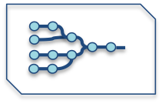

High Level Process View
1
2
3
Clients from different geographies send customization request to Cognizant
Cognizant does the necessary customization in solution and shares back the version.
Setting Context: ASM and Brand Managers to identify profiling parameters within their region
4
6
Distribution among Reps: The application link is shared with field reps with latest market configuration
Tracking performance: Portfolio Owners can assess the performance and take strategic decisions.
5
Continuous Model
HCP 360 ⁰: Consumer behavior and trends using open source data
Account Profiling: Rep enters HCP interaction information .
Utilization of other Data sources: Use of available data sources (primary & secondary) for additional analysis
Segmentation : Accounts are segmented using AI/ML Clustering
NBA/NBP: Suggestion for Reps to set their strategy and goal .
Evolving Models: Inputs stored across users to study key driving factors and evolve Propensity model

Slide 8


Pre-Post Assessment
Before
After
Medical Reps:
Used to receive directives from Brand team without much rationale behind such decision
In care of territory re-alignment, insights on relationship build with HCP over time is lost
No real time assist during HCP interaction. Most of the support come pre-post interaction
ASM/Brand Manager
Most of the segmentation and marketing tactics are hunch based having high probability of not getting optimum target result
Data sharing between field force and organization is archaic, leading to slower process
Silos process
Medical Reps:
With continuous use of solution, reps to get more clarity on organization objective
No loss of information as all data get’s stored centrally
Reps gets support for the calls (NBA) as well during real time interaction with HCP
ASM/Brand Manager
Factor determination and segmentation to be scientifically using ML algorithms and taking into consideration market bias
Near real time updates provide better control and support quick decision making
Owing to centralized process, best practices are shared across organization

Slide 9
Innovation / Business Impact
Purpose: Highlight the benefits of the solution.
Following are 4 specific use case slides which showcase Client benefits we can derive from the solution. But the overall objective of the solution will not be limited to these
Considering this will be a niche analytics/data science solution, most of the benefits mentioned in the use cases are intangible benefits which eventually help improve their marketing/SFE strategies and promote the brand sales.
For computation of tangible benefits, given this will be a universal solution for all brands and sales force, the tangible benefit will vary based on Brand (blockbuster, generics) and size of sales force

Slide 10





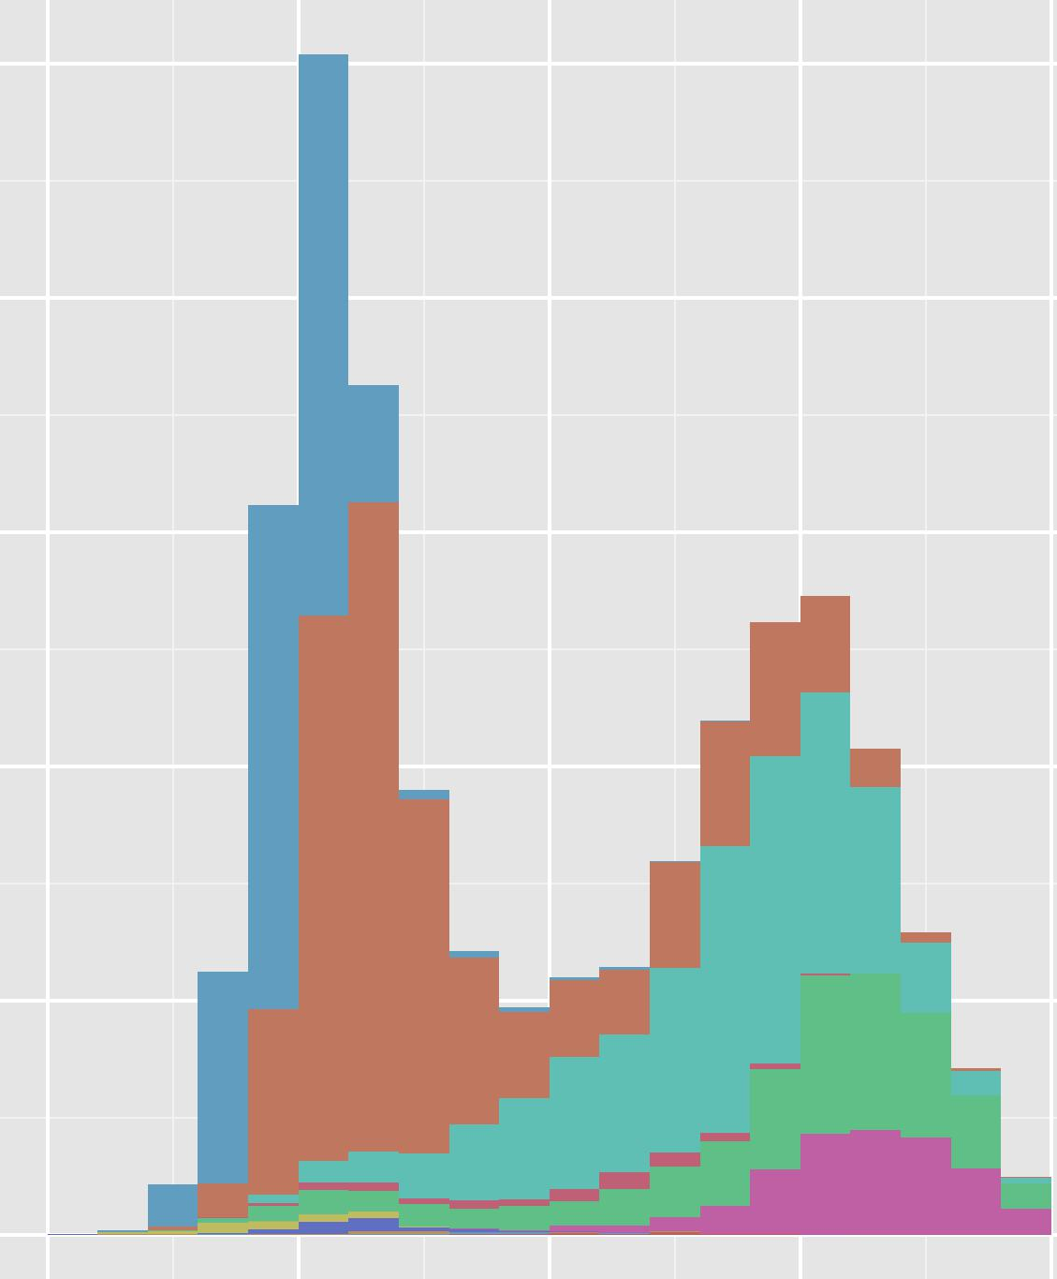

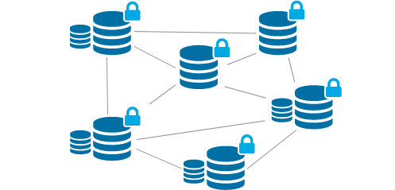
Innovation / Business Impact
Situation
Seeking market intelligence and an understanding about the primary customer segment i.e. physicians for segmentation and targeting to optimize the downstream activities for ensuring better outreach and throughput.
Solution Approach
Potential Benefit
Step 3
Step 2
The targeting exercise will help the client in developing optimum call plans and focused targeting campaigns
Targeting ensured better accessibility and profitability in the long run
Step 1
K-Means clustering to arrive at the best suited sets of clusters
Further Analysis can be done on other attributes such as on drive distance, drm, no see and PDRPs in order to arrive at the appropriate target list
Identifying the key influential factors in terms of Market Trx, Brand TRx, Commercial and Cash contribution, writing pattern in generic and branded medicines, specialties etc. to divide the entire customer base into several profiles
Data
Rx data

Slide 11
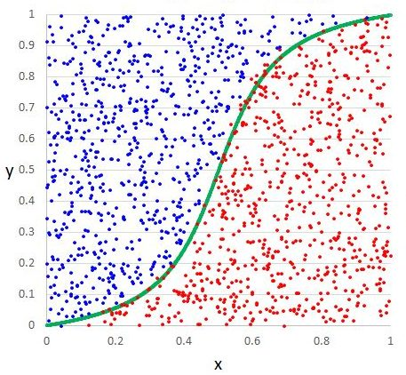
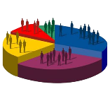
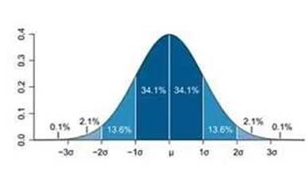
Use Case 2 | Analyzing HCP writing pattern
Situation
Study the writing pattern of prescriptions and predict the writing behavior based on the segment, number of shipments, discontinued patients and brand sales.
Solution Approach
Potential Benefit
Step 3
Step 2
Client will be able to identify the key writers as well as understand the various reasons for prescription writing
Redefine target list and change messaging pattern for the segmented physicians
Step 1
Propensity model / Decision tree for determining factors driving physician behavior
Descriptive Statistics to study prescription pattern to generate insights and identify key variables
Physician Universe Segmentation to be done by exploring the drug prescription data
Data
NRx, TRx, Specialty Pharmacy

Slide 12
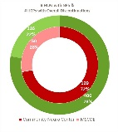
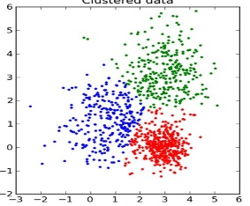
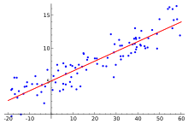
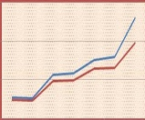
Use Case 3 | Sales Aid Impact Analysis
Situation
Impact of use of Digital sales aid containing specific messages focusing on Safety, Efficacy and Support by the medical reps during calls, on the writing pattern of the prescribers
Solution Approach
Potential Benefit
Step 3
Can help Client to identify the focus HCP universe for their product and also the right combination of messages to be delivered.
Insights to help in better call planning, customer segmentation and targeting strategies
Step 2
Step 1
Linear Regression model across HCP clusters to identify the level of influence of each element contributing to TRx
Pre-post impact assessment to check impact of sales aid calls made in each month vs change in TRx
Clustering of HCPs from different decile buckets based on trends and prescribing patterns
Analysis of call patterns with different category of messages delivered to HCPs over the time period
Data
Call Activity Data
Digital Content data

Slide 13
Use Case 4 | Segmentation for a Launch Product
Situation
To support launch and maximize product uptake, we need to understand most valuable segments of the physicians and the optimal
guidance to detail the physicians
Solution Approach
Potential Benefit
Step 3
Step 2
Actionable Segments meeting current/future brand needs considering all the relevant variables.
Identified most favorable segments and the detailing strategy/frequency based on cost guidance.
Latent class analysis (LCA) to identify unobservable subgroups within a population based on the set of variables
Clusters were profiled and analyzed to create actionable segments using Shapley regression.
Step 1
Important variables were derived/identified from different secondary sources (e.g. Prescriptions, New therapy start, Payer plans, formulary status etc.)
Create the most relevant physicians universe after segmentation and plan strategy for each of the segments to maximize the planned uptake of the product
Data
Prescription ,APLD, Managed Care

Slide 14
Prototype Readiness
Purpose: Highlight the prototype specifics.
What critical feature of the solution you would want to showcase as a working prototype as part of Idea Harvest 2.0?
We would like to showcase how a medical rep can use this tool to ease his profiling and targeting activities
Use of ML algorithms to define HCP potential and segmenting them in meaningful clusters
Analysis that can help Brand Manager take marketing decisions
Is there a lab or technical support or any other support you are looking for in developing the above as a prototype? (Be specific with your asks to enable the core team to provide support as much as possible.)
For Prototype, we intend to use open source (Python) programming language.
Have you communicated to your client about this particular solution and is he interested?
No. For our Client we are mostly engaged in commercial reporting and analytics piece. We would like to get some intel on their SFE needs before moving forward. However this solution has appeal in other clients as well.
Would you be willing to showcase the prototype as part of Idea Harvest presentation if your client is invited as one of the panelists? Or are there any reservations?
As mentioned above, we need to have more information on Client landscape in this area before presenting the solution

Slide 15
Recommended Implementation Schedule
Program Plan | Description | Activities / Feature
Prototype Development | Developing Segmentation and Targeting module using AI/ ML algorithms and detailed out business use cases to be tested. | Data Input and Consolidation Feature
 |  | Customer Profiling
 |  | Customer Segmentation & Propensity Score
 |  | Graphs and Insights
 |  | Customer 360
Phase | Activities | Type |  | Jun-19 | Jul-19 | Aug-19 | Sep-19 | Oct-19 | Nov-19 | Dec-19
Planning | Layout Design, Use Case Recognition | Planning
Solution Development | Conversion of modules to framework | Development
 | Potential Datasets Identification (Internal, Commercial, Open Source) | Research
 | Deployment of Data Science Models | Development
 | Integration of modules and testing | Testing

Slide 16
Risks
Purpose: Highlight the key risks to the solution.
As there are few tools already available in the market, until we address core business problems of any client, the solution will be hard to sell. As the problem differs from one to another client, we also need to be nimble in our planning
Although we are proposing a Global solution, one of our key target area will be ROW region since standardized SFE solution is need of the hour in these geographies. However, since most of ROW markets have budget constrains, our solution need to be customizable so that only specific modules can be applied
Client might want us to implement only for few of our modules on top of other existing platform which they might be using. We need to plan and make our solution flexible enough to be deployed in parts and be able to interact with other applications
Since our solution/application is to be used by field representative, it needs to be user friendly, else the participation from Reps will be low and it will defeat the purpose

Slide 17
Financials—Costs
Purpose: Summarize the financial costs of the solution
Cost for Tool (Licensing Cost) : $200 - $300K (yearly cost per brand per implementation)
Consulting support: $125 per hour for onsite, $45 per hour offshore
Assumptions:
The application to be hosted in Client’s environment. Incase Client needs support of Cognizant infrastructure, the cost logistics will be estimated separately
Consulting support will be on fixed capacity basis (based on work volume and customer requirement)
Any customization with the application post deployment has to be done through separate CR
* Please note all the figures are currently high level estimates and may change post prototype development

Slide 18
Financials—ROI
Purpose: Explain the ROI for your solution.
Why should Cognizant invest in this solution?
With our experience in this field and also through some research, there are no existing tools in SFE area which covers the extent of business problems as we intent to target through our solution
Cognizant currently doesn't have any SFE solution with AI/ML capabilities. This solution can help Cognizant to expand analytics base in specifically ROW market where most companies seek simple and standardized solution for SFE
Why should your client invest in this solution?
Currently the SFE activities are mostly done on silos and thus large Life Science organization doesn’t have a single model to compare the best of strategies. Our solution intends to bring centralization across all SFE activities so that Top leadership can have better view and compare one region with another without much challenge.
Another important feature is that generally the cyclic SFE activities (Alignment, Segmentation, Profiling, Targeting, etc.) takes significant amount of time. Our intent with this solution is to reduce the time required for these activities drastically using AI/ML so that Marketing Heads/Brand Managers can focus more on their strategies while the reps can focus on their call planning and interactions.

Slide 19
Thank You

